Slide 1
Chapter 9
Process Modeling – Part 2

Slide 2
Structured Analysis
1. Draw Context DFD to establish initial project scope
2. Draw functional & event Decomposition Diagrams
3. Create Use-case List to define events for which the system must have a response
4. Draw an Event DFD for each event
5. Merge event DFDs into a System Diagram
6. Draw the detailed Primitive DFDs
7. Document data flows and processes in data dictionary

Slide 3
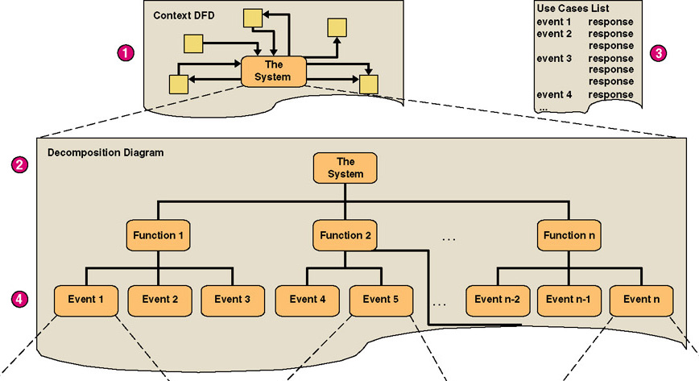
Data Flow Diagrams

Slide 4
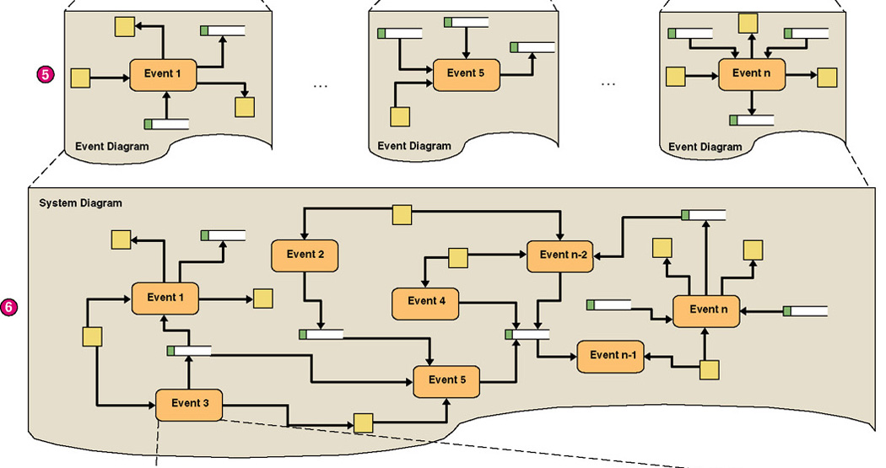
cont’d

Slide 5
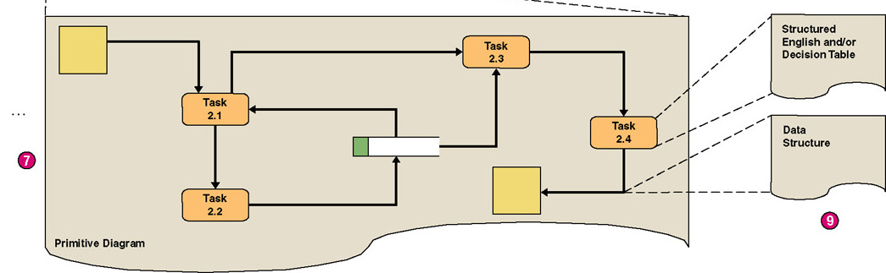
cont’d

Slide 6
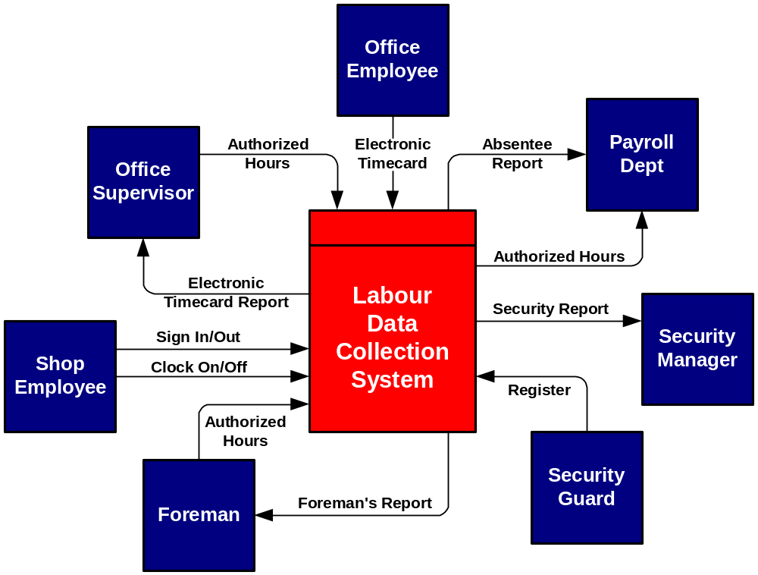
Context Data Flow Diagram

Slide 7
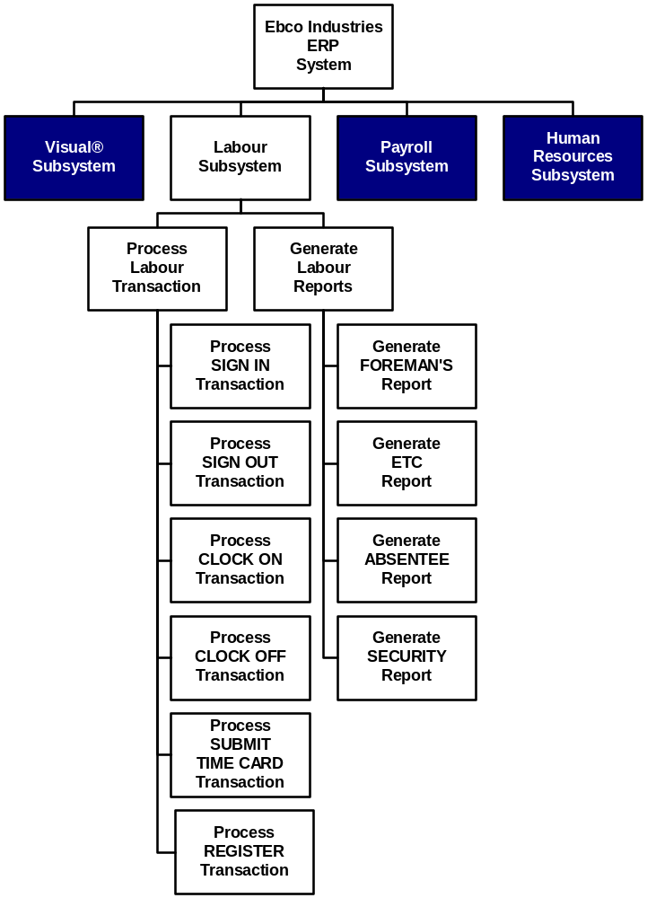
Event Decomposition Diagram

Slide 8
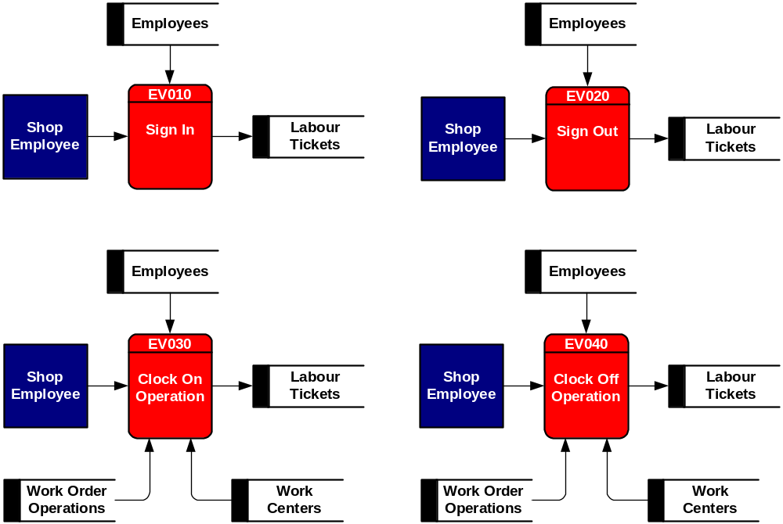
Event Data Flow Diagrams

Slide 9
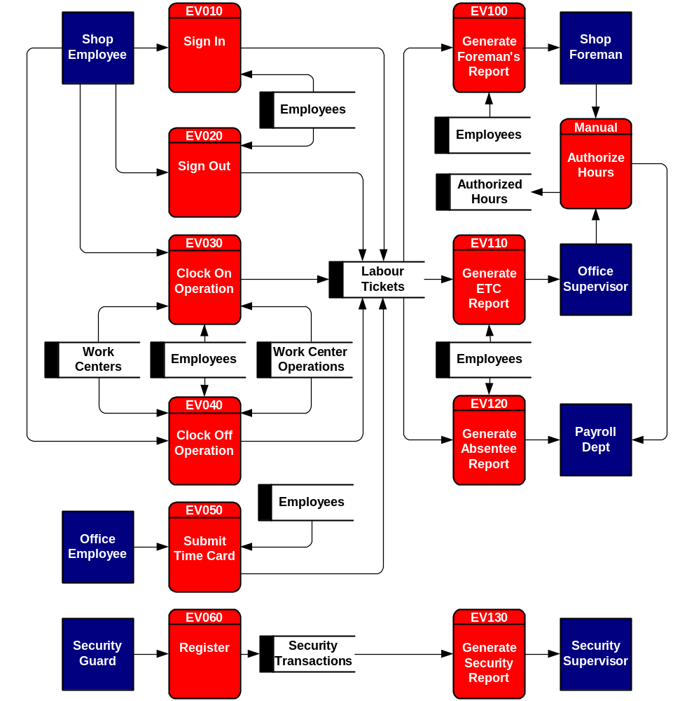
System
Data Flow
Diagram

Slide 10
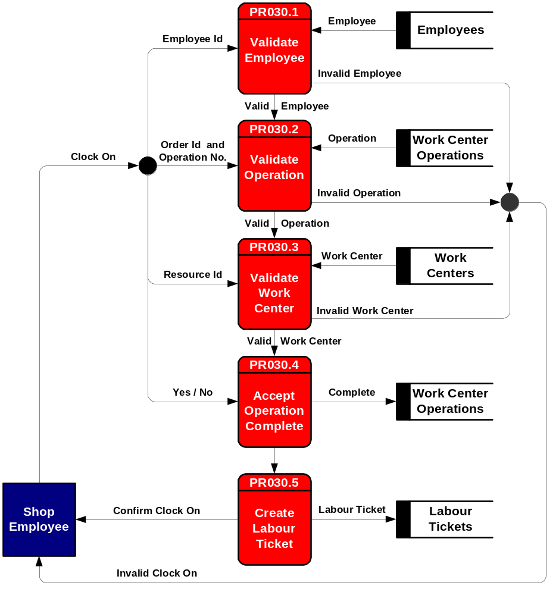
Primitive
Data Flow
Diagram

Slide 11
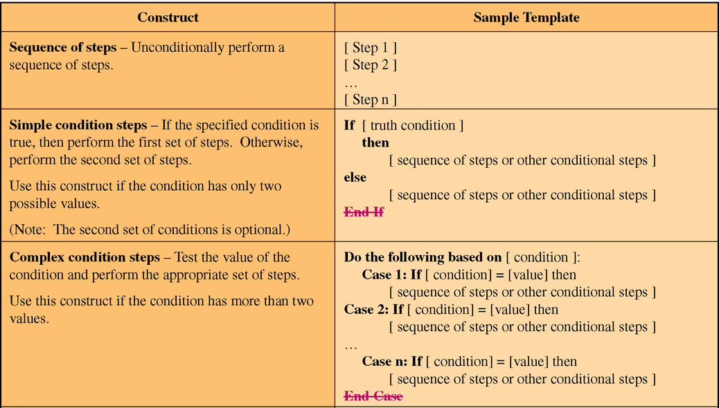
Structured English

Slide 12
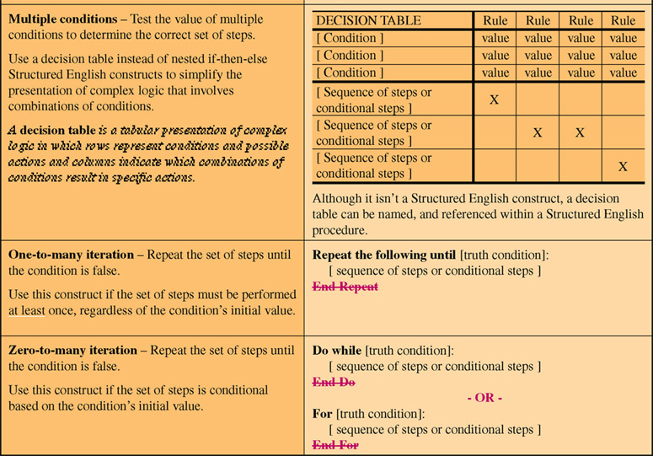
cont’d

Slide 13
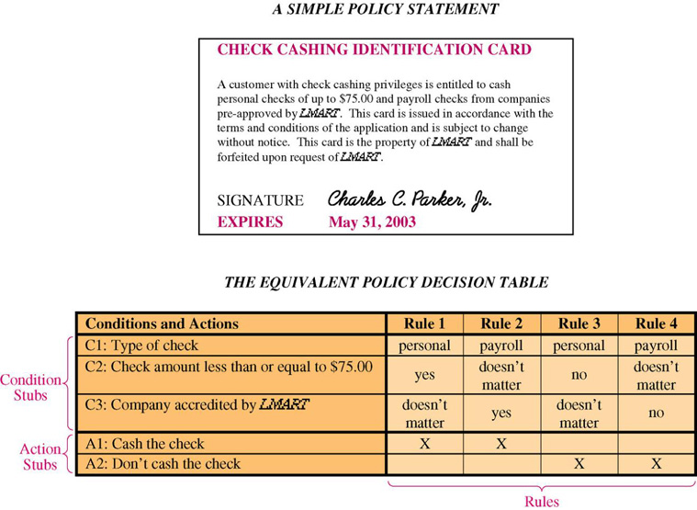
Policy

Slide 14
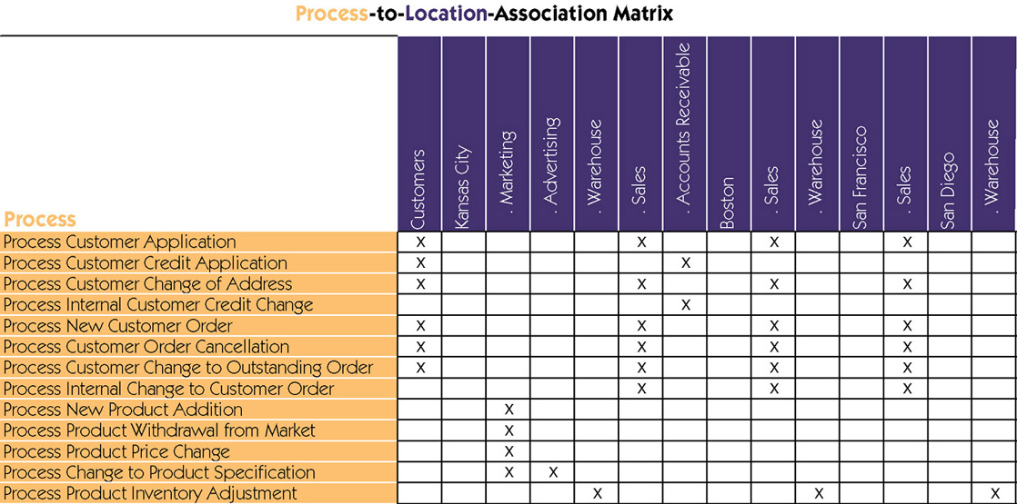
Documenting Processes

Slide 15
End of Part 2

